Slide 1
Afghanistan
Soviet – Afghan War 1979-1989

Slide 2
Ancient history
Written history goes back 3,500 years
Conquered during Islamic Imperial Age (642 C.E.)
  Introduced Islam as the area was taken over
  Most people in the region become Muslims
  History of conquests, monarchies and dynasties until the Europeans arrive (1830’s)

Slide 3
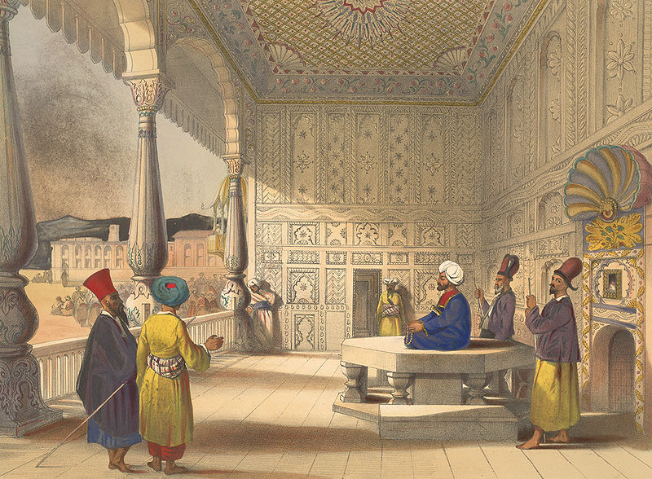
English and Russians invade the 1830’s
West wanted to limit the power of the Persian Empire
  When they take over, est. the boundaries of modern Afghanistan
  Area remained under British control until 1919

Slide 4
Monarchy gains independence 1919
King plans to modernize
  Freedom for women
  Bring Afghanistan into the modern age
  Co-ed schools and banning the veil for women
These reforms anger conservatives
  Tribal leaders forced him to give up the throne in 1929.

Slide 5
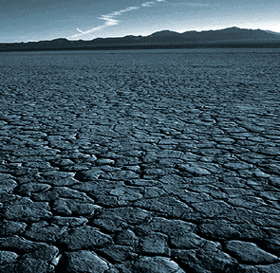
King Khan: 1943-1973
Creates closer ties to USSR
Allowed political parties to form
  People’s Democratic Party of Afghanistan (PDPA) – Marxist ideaology
Under the King’s rule, economy tanks, drought causes famine = everyone is mad…
  Prime Minister takes over gov’t in 1973

Slide 6
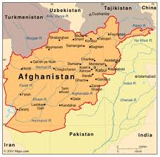
Prime Minister In Charge 1978
New Constitution
  Women’s rights
  Economic Reforms
Reality…
  Arrests for all those who oppose new gov’t
  Mass executions
  Closer ally of the U.S.S.R.

Slide 7
1978
Prime Minister has a leader of the PDPA killed
PDPA gets REALLY mad.
  Organized the military against the P.M.
  Killed him
PDPA take over:
  Pro women’s rights
  Asks USSR to help restore nation

Slide 8
PDPA 1978-1979
Reality…
  Kills all opponents
  Targets ethnic and religious minorities
  Target wealthy and political elites
Sign agreement with the USSR that the USSR can “provide military support” in a crisis
Continues intense repression … angering Afghans and forcing the army to desert the gov’t…

Slide 9
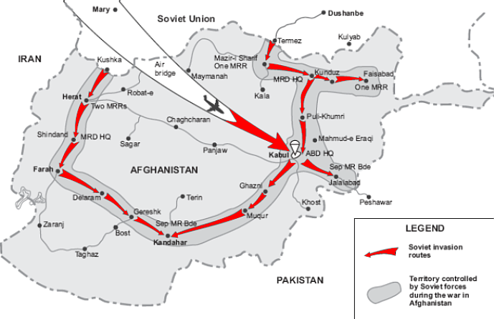
1979
USSR invades to “help stabilize”
Most Afghans hate their gov’t so war breaks out between the people and the governments of Afghanistan and the USSR
= Soviet/Afghan War 1979-1989
U.S. also opposed USSR and so we start training Afghans to fight = give weapons, and send money

Slide 10
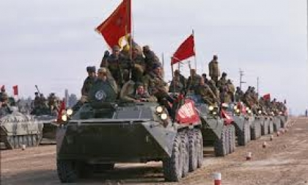
Why go to war?
Soviet Perceptions:
Religion is evil and they should “free the oppressed”
Would give U.S.S.R. access to the Indian Ocean and trade
Would create an ally of the U.S.S.R. in the Middle East
Natural resources (ore, minerals, gas, copper, uranium)

Slide 11
Why go to war?
Afghanistan’s point of view:
Fighting for religion and way of life
Fighting for sovereignty
So…
They form militant groups to fight the invading forces.
= Mujahedeen
Carter and Reagan both support Afghan efforts to fight Soviets. Reagan even calls the U.S.S.R. the “evil empire”

Slide 12
Impacts:
Afghanistan
1 million Afghans die
5 million flee fighting and leave (primarily go to Pakistan)
Soviets:
Spent billions to win a war
Contributed to economic collapse of the USSR
Compared to US loss in Vietnam
50,000 troops died

Slide 13
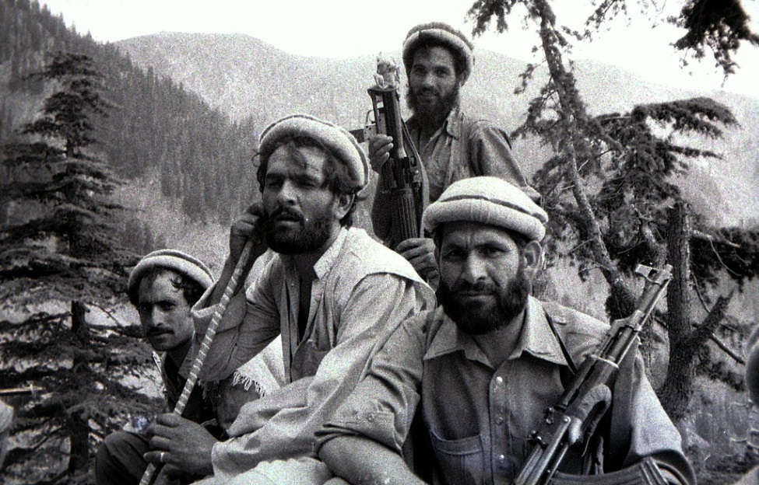
Mujahedeen
1989
  USSR collapses due to economic failure
  USSR withdraws troops from Afghanistan
  US ALSO leaves
  Afghanistan is a lawless, poor, war torn area
Mujahedeen – warriors who set up areas of control and begin to fight each other
  Horrible atrocities are committed as they fight for tribal control.

Slide 14
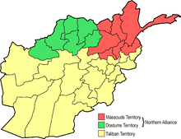
Taliban (early 90’s)
Taliban: group of religious/political leaders
  Step into the power vacuum and begin to take control
  Set up Islamic State in parts of the country
    No rights for women
    No schooling for girls
    No work
In the North – Massoud : moderate leader fighting the Taliban and asking for Western help. Warned they were terrorists…

Slide 15
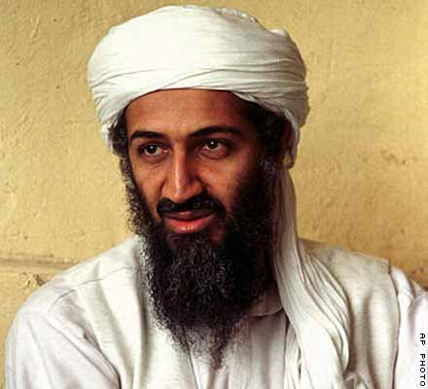
Al ’Qaeda
Bin Laden: Taliban sympathizer and soldier
Eventually sets up his own area in Afghanistan
  Training troops (using Pakistan’s support)
  Finally ends moderate control of the rest of Afghanistan.
  Sept 9, 2001 – Massoud killed in a suicide bombing attack
  Al’ Qaeda attacks U.S. on 9.11.01

Slide 16
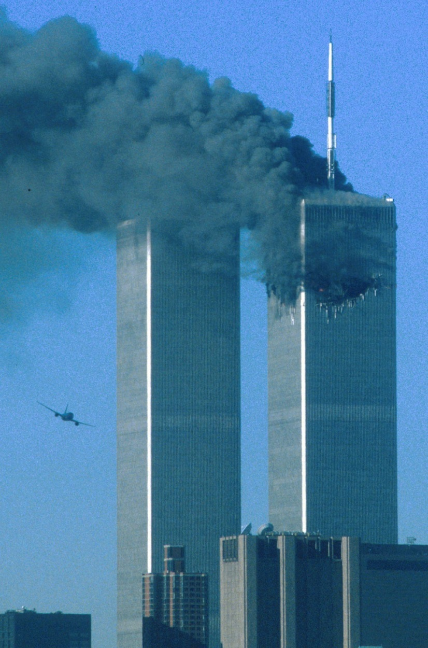
9-11

Slide 17
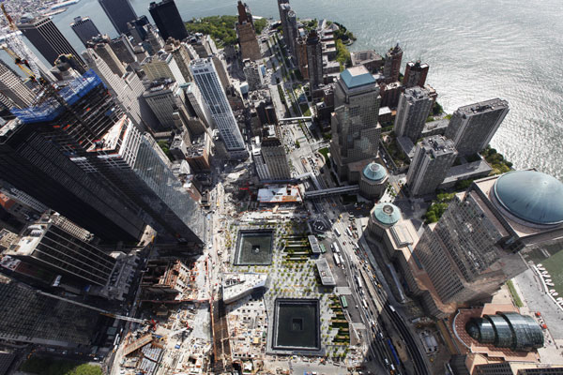
9-11

Slide 18
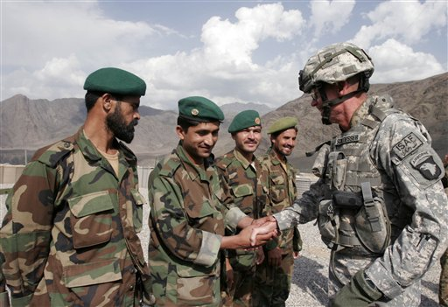
2001
U.S. invades Afghanistan
  Still there today…
  Concerns are Pakistan still funneling supplies, support to Taliban
  Pakistan may be sheltering Taliban
  Bin Laden killed in Pakistan in 2011

